Slide 1
Building the business migration case with Windows Server and SQL Server
Presenter Name

Slide 2
Abstract and learning objectives
In this whiteboard design session, you will learn to design a strategy for migrating existing on-premises Windows Server and SQL Server workloads to Azure. Throughout the whiteboard design session, you will look at the virtual machine (VM) pricing, integrated management of cloud, and on-premises workloads using Azure Arc, and migrating SQL Server workloads to Azure.
At the end of the workshop, you will be better able to design a migration strategy for Windows Server workloads to Azure VMs, SQL Server workloads to Azure SQL Managed Instance (SQL MI), and simplify workload management using Azure Arc.

Slide 3
Step 1: Review the customer case study
Outcome
Analyze your customer needs.
Timeframe
15 minutes

Slide 4
Customer situation
Tailspin Toys is a global manufacturer of children’s toys headquartered in Milwaukee, WI.
They are currently hosting mission critical workloads in an on-premises datacenter.
On-premise datacenter hardware scheduled to be either retired or replaced within 24 months.
Kaylee Frye, CTO of Tailspin, has already had their Technical Architects create an assessment of their current environment, of which they’ve already identified apps and workloads to migrate first.
Their workloads are primarily Windows Server and SQL Server Virtual Machines (VMs).
Their on-premises environment consists of over 250 servers and VMs and are hosted using Hyper-V.

Slide 5
Customer situation (continued)
They want to implement the Azure migration in multiple phases and want to begin with a POC migration using a workload they’ve identified.
For the first phase of the Azure migration, they’ve identified an initial workload consisting of Window Server VMs hosting .NET Framework applications and SQL Server databases.
They’ve also identified some additional workloads that will remain on-premises but would like to ease their management burden.
They’ve already worked with a service provider to set up an Azure ExpressRoute circuit to integrate on-premises datacenter with Azure.

Slide 6
Customer needs
Migrate existing workloads to Azure as efficiently as possible.
Lower the management burden with a consolidated view to manage all VMs and Servers cross Azure and on-premises.
Security is extremely important when integrating the on-premises network and workloads with Microsoft Azure.
With Windows Server 2012 and Windows Server 2023 R2 extended support ending October 10, 2023, the new Azure VMs will need to be deployed using a newer version of Windows Server.

Slide 7
Customer objections #1
It appears there are multiple options for hosting SQL databases in Azure. What's the best option to ensure compatibility?
What kind of downtime will be incurred when migrating the Windows Server and SQL Server workloads to Azure?
What are the options to roll back to the on-premises VMs if the migration fails?
What's the best way to handle managing all our VMs across on-premises and Azure? We do have workloads that will not be migrated to Azure.

Slide 8
Customer objections #2
Tailspin has negotiated an Enterprise Agreement (EA) with Microsoft for their Azure consumption. What can you do to ensure estimates reflect our EA discount?
Securing and monitoring our on-premises workloads is extremely important. What options does Azure offer to extend this into the cloud?
Would there be further savings from the use of PaaS services?

Slide 9
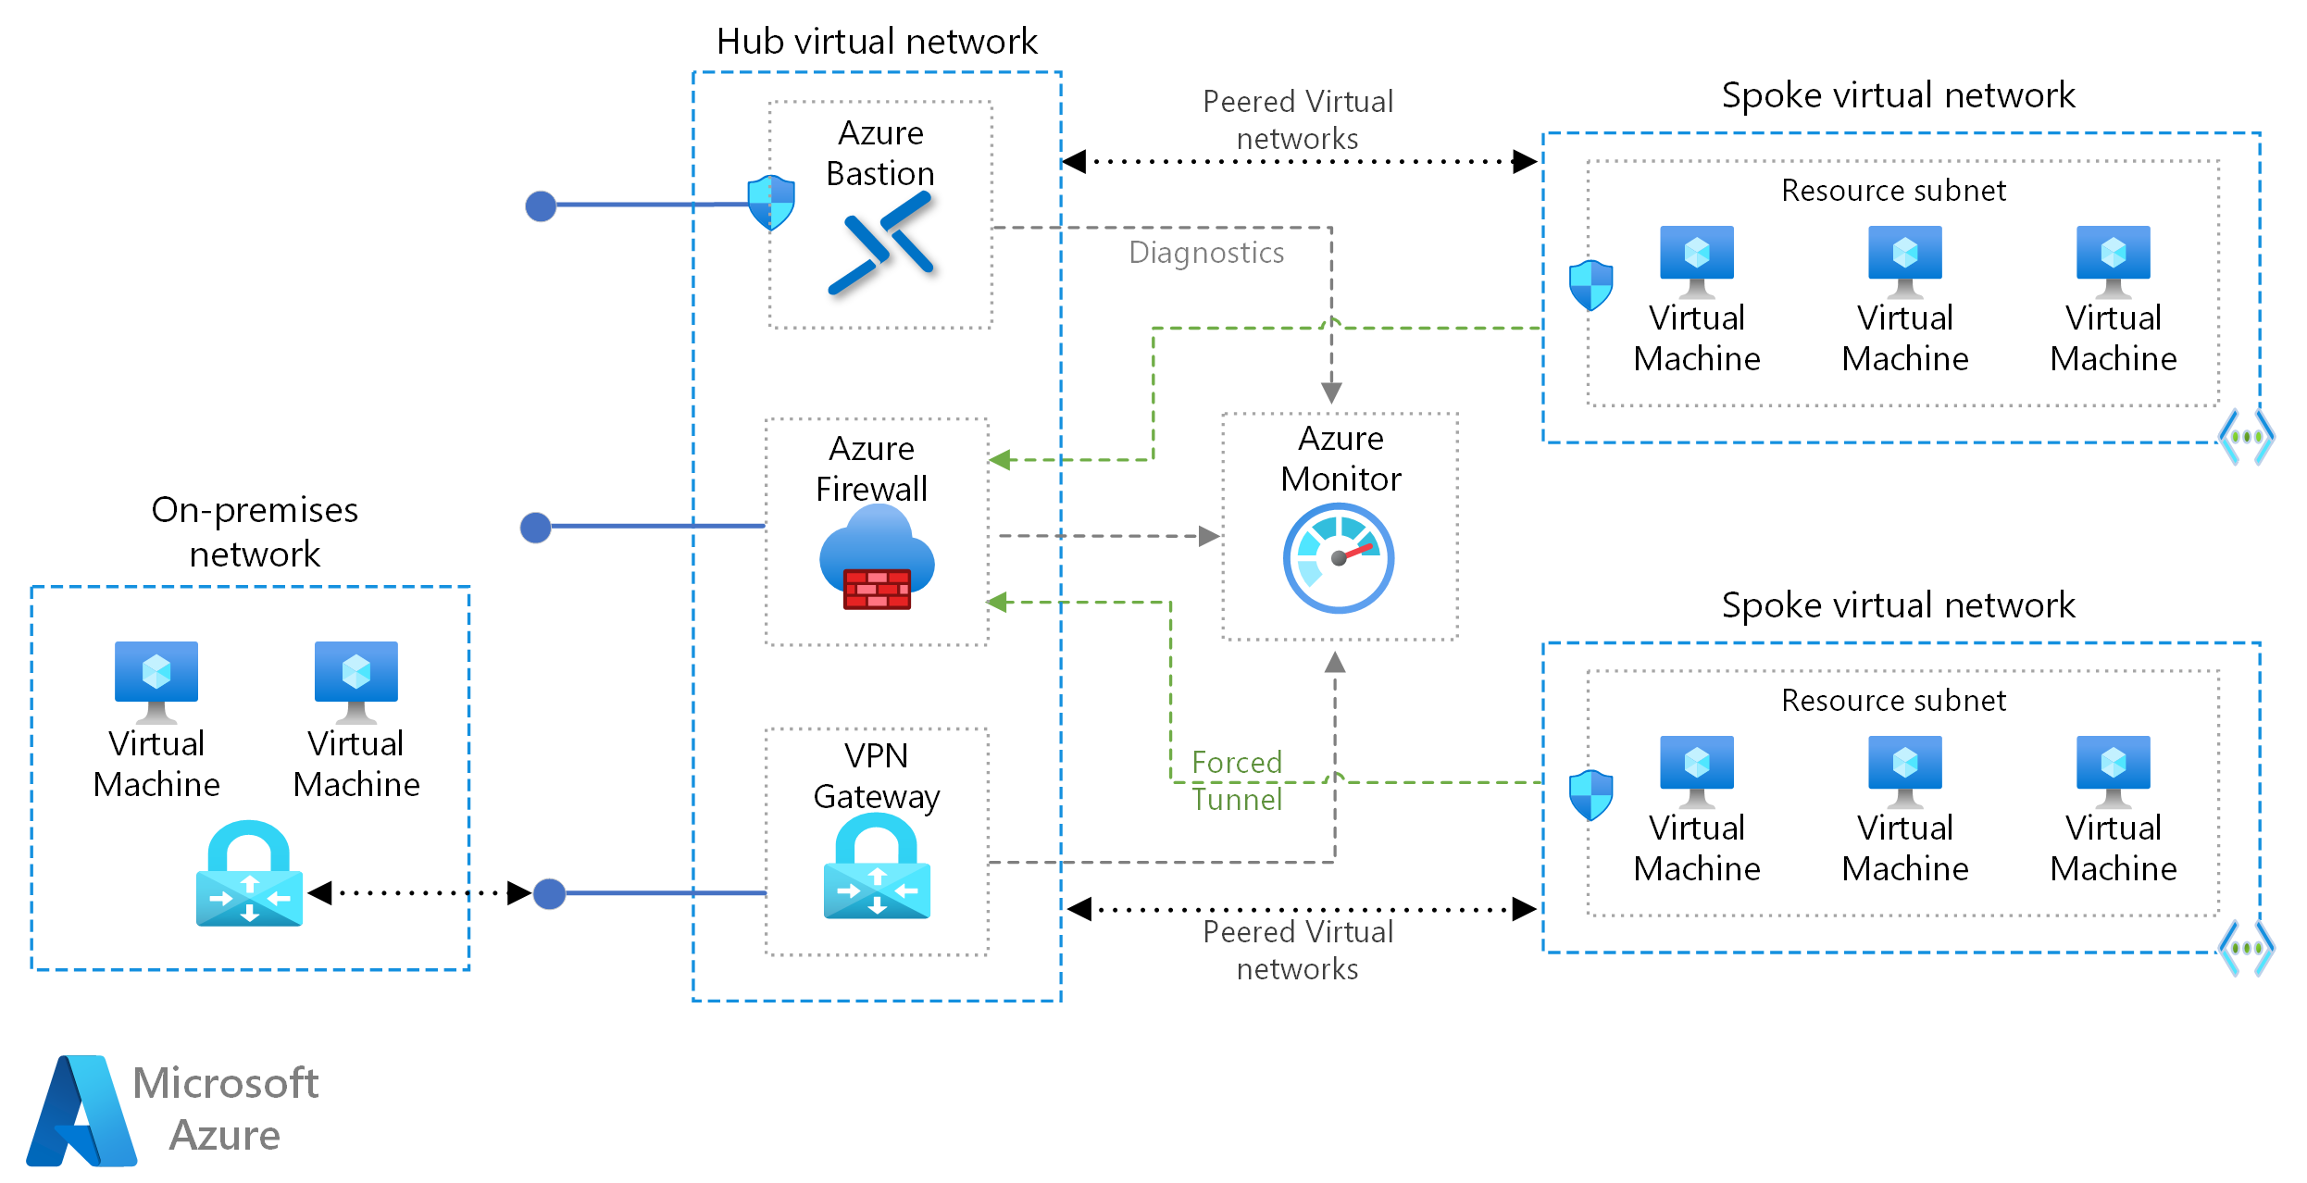
Common scenarios
Notes:
The hub virtual network acts as a central point of connectivity to many spoke virtual networks. The hub can also be used as the connectivity point to your on-premises networks. The spoke virtual networks peer with the hub and can be used to isolate workloads.
https://docs.microsoft.com/azure/architecture/reference-architectures/hybrid-networking/hub-spoke

Slide 10
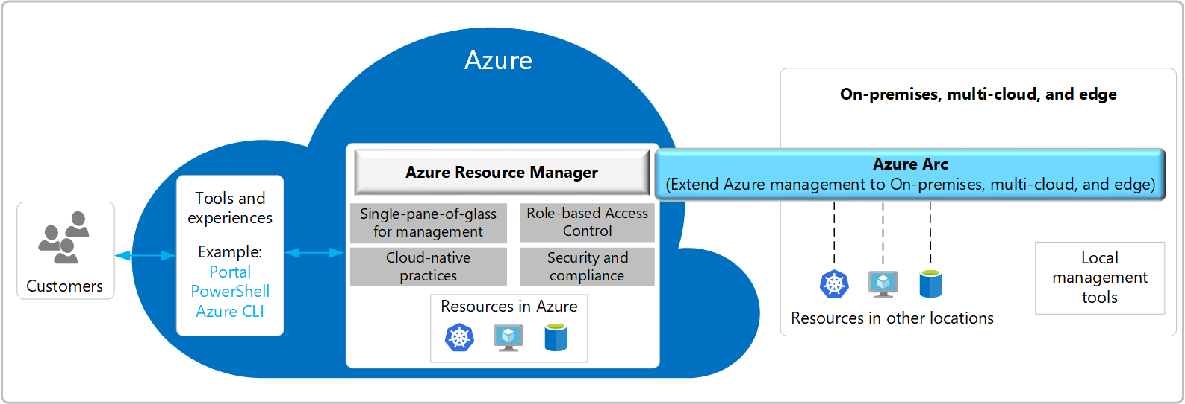
Common scenarios
Notes:
Azure Arc simplifies governance and management by delivering a consistent multi-cloud and on-premises management platform. Azure Arc provides a centralized, unified way to manage your entire environment together by projecting your existing on-premises resources into Azure Resource Manager.
https://docs.microsoft.com/azure/azure-arc/overview

Slide 11
Step 2: Design the solution
Outcome
Design a solution and prepare to present the solution to the target customer audience in a 15-minute chalk-talk format.
Timeframe
1-2 hours
Business needs | Respond to questions outlined in your student guide and be prepared to present your solution to others.
Design | Design a solution for as many of the requirements in your student guide as time allows.
Pricing | Provide an estimate of the costs associated with each aspect of your solution, following the questions in your student guide.
Prepare | Identify any customer needs that are not addressed with the proposed solution. Identify the benefits of your solution. Determine how you will respond to the customer’s objections. Prepare for a 15-minute presentation to the customer.

Slide 12
Step 3: Present the solution
Outcome
Present a solution to the target customer in a 15-minute chalk-talk format.
Timeframe
30 minutes (15 minutes for each team to present and receive feedback)
Directions
Pair with another team.
One group is the Microsoft team and the other is the customer.
The Microsoft team presents their proposed solution to the customer.
The customer asks one of the objections from the list of objections in the case study.
The Microsoft team responds to the objection.
The customer team gives feedback to the Microsoft team.
Switch roles and repeat Steps 2-6.

Slide 13
Wrap-up
Outcome
Review the preferred solution for the case study.
Timeframe
15 minutes

Slide 14
Building the business migration case with Windows Server and SQL Server
Whiteboard Design Session – Preferred Solution

Slide 15
Preferred target audience
Kaylee Frye, CTO
Technical Architects

Slide 16
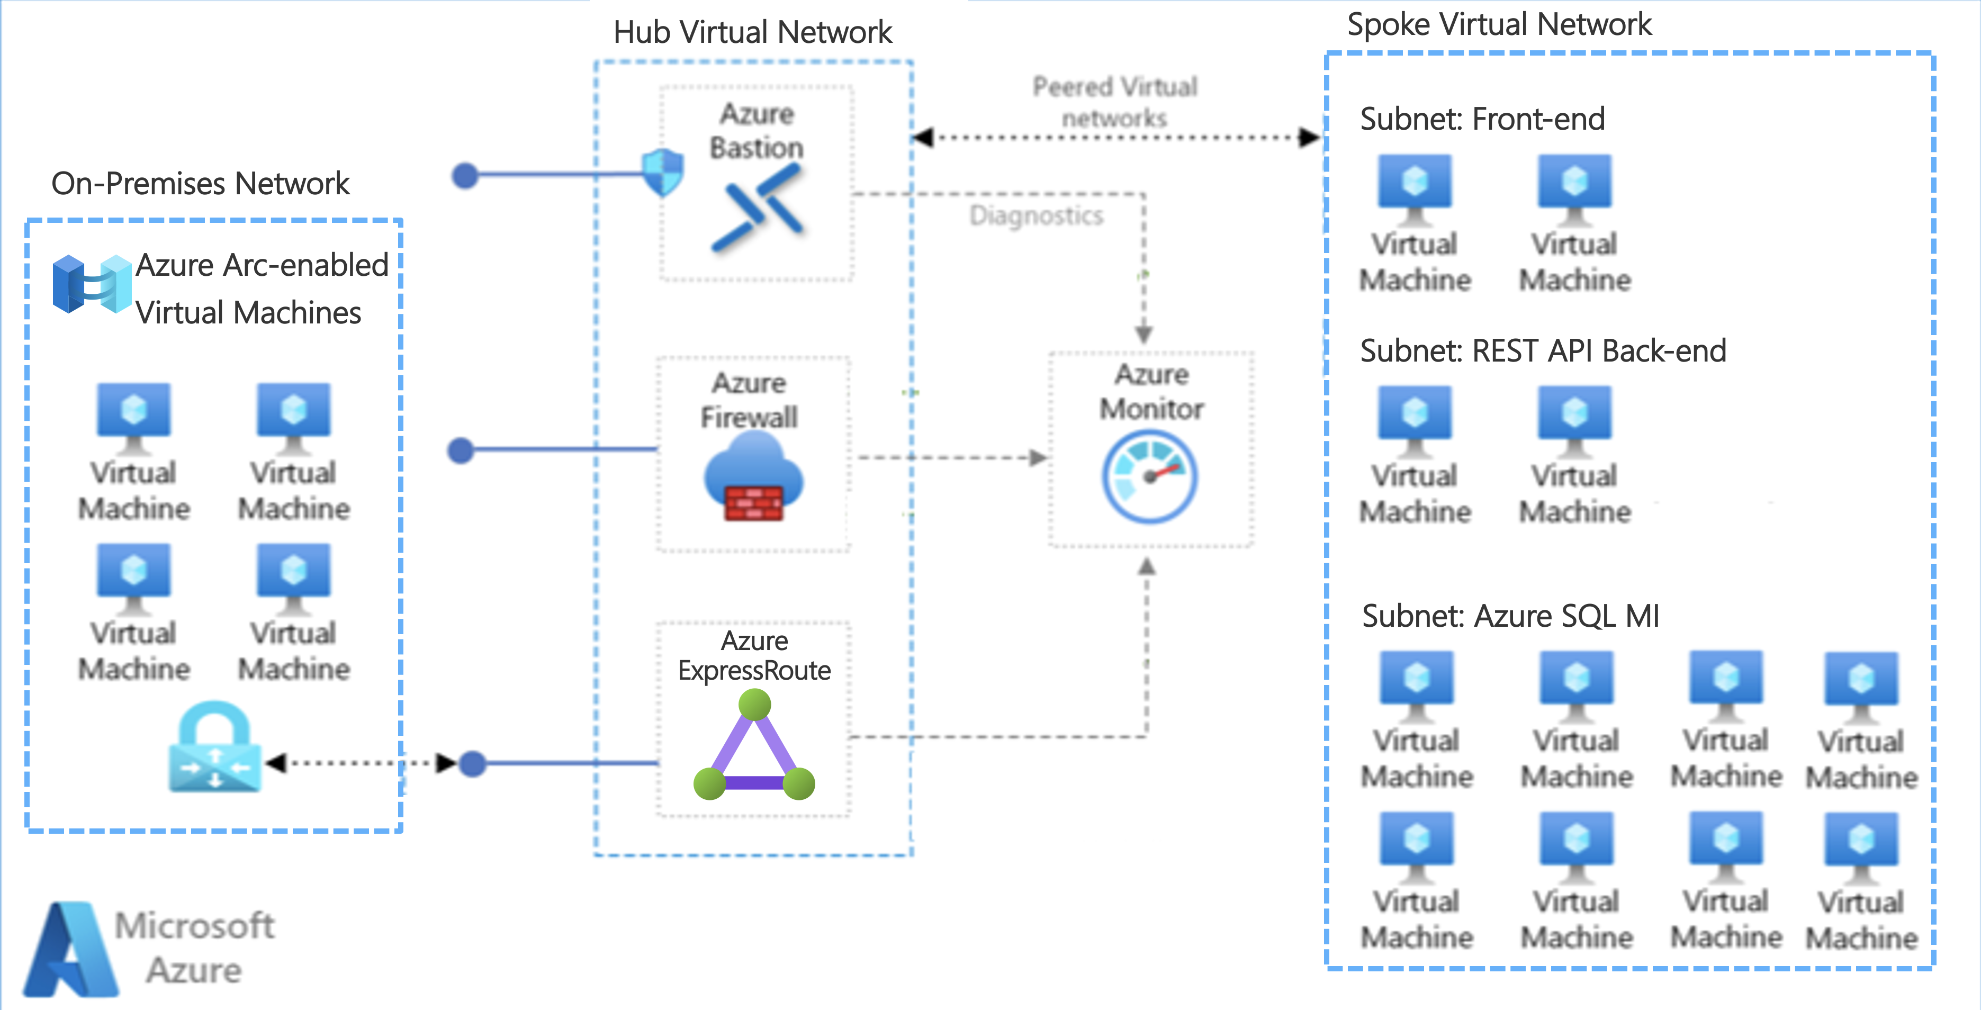
High Level Architecture
Notes:
Tailspin has Hub and Spoke networking setup with Azure ExpressRoute connected to Azure.
The Web Application Front End, REST API Back End, and SQL Server Databases have been migrated to Azure and are running in Virtual Machines hosted within a Spoke VNet in Azure that is peered with the Hub VNet.
Each application in Azure is contained within its own Subnet with Network Security Groups securing them accordingly.
The on-premises VMs are Azure Arc-enabled so they can be managed with a single pane of glass along with the Azure VMs using the Azure Portal.
Other components that may be setup according to the clients requirements are:
Azure Bastion for secure Remote Desktop access to Azure VMs
Azure Firewall to protect the Web Application Front End (a common component to use in a secure Azure networking model)
Azure Monitor setup to implement monitoring of Azure VMs

Slide 17
Migration #1
How will you migrate the on-premises workloads to Azure?
Since it is recommended to upgrade the version of Windows Server from 2012 to 2022, it will be necessary to create new servers. In this case, Azure Migrate cannot be used to move the on-premises VMs into Azure as-is. New Azure VMs need to be created with the application workloads deployed to these new Azure VMs.
Application deployment automation is already being done using Azure DevOps Pipelines, so there should be minimal effort necessary to extend those pipelines to deploy to the new Azure VMs.

Slide 18
Migration #2
How will you migrate the SQL Server workloads to Azure?
For the SQL Server databases, Tailspin should use the Microsoft Data Migration Assistant (DMA) to assess database migration readiness. Using DMA to examine the existing on-premises databases will report any compatibility issues ahead of attempting the migration. Typically, SQL Server databases can be migrated to Azure SQL Database or Azure SQL Database Managed Instances. Also, Azure SQL Managed Instances offers greater compatibility with the on-premises SQL Server. SQL Server in Azure VMs could be used; however, this will negate the advantages of using a managed service that eliminates the requirement for ongoing VM maintenance.

Slide 19
On-premises Workload Management #1
Which workloads should remain on-premises and which migrated at a later date?
Among the workloads that have been identified for advice on migration to Azure, the Windows Domain Controllers are recommended to keep in the on-premises datacenter at this time.
It is recommended to migrate the on-premises Network File Shares and Ubuntu VMs to Azure in a later phase of their Azure adoption. A phased approach to the migration process will enable each workload to be methodically migrated to Azure while limiting the risk of downtime across the organization.

Slide 20
On-premises Workload Management #1 (cont.)
Which workloads should remain on-premises and which migrated at a later date?
It is recommended to migrate the on-premises Network File Shares to Azure Storage File Shares. This would allow for a fully managed service to host the file shares without the requirement for ongoing VM maintenance. However, the configuration and usage of the File Shares will need to be assessed and discussed with Tailspin to ensure Azure Storage File Shares offer the features they need. If not, the Network File Shares could be migrated to Azure VMs if necessary.
It is recommended to migrate the on-premises Ubuntu 18.04 Linux VMs to Azure. These could be migrated similarly to the Windows Server VMs, and the server requirements will need to be discussed with Tailspin. As was mentioned, they may be phasing out some of their web applications, as a result it may not be necessary to migrate all their on-premises servers.

Slide 21
On-premises Workload Management #2
How will they reduce the burden of managing both on-premises and Azure workloads?
After some of the VMs are migrated to Azure, and others are still on-premises, it may be more burdensome to manage all their workloads in one place. For this, the use of Azure Arc is recommended. Azure Arc will enable Tailspin to centrally manage all their VMs in Azure and on-premises. Azure Arc supports managing both Windows and Linux servers and VMs.
The on-premises Windows and Linux VMs can be Azure Arc-enabled by installing the Azure Connected Machine agent. The agent brings with it the ability to manage the VMs with Azure Arc, as well as all the great features the service has to offer.

Slide 22
Pricing
What is the estimated cost for the workloads after being migrated to Azure?
Since Tailspin Toys and their current on-premises data center is in Milwaukee, WI. The nearest Azure Region to use will be North Central US.
There will need to be additional discussions with Tailspin Toys to determine the extent of Disaster Recovery (DR) they require for this initial set of workloads being migrated to Azure.

Slide 23
Pricing (continued)
Component | On-Premises | Azure VM Sizes
Web VMs (Web App Front End) | 2x VMs (2 Cores, 16 GB RAM) | 2x D4s v5 VMs (4 vCores, 16 GiB RAM)
Web VMs (REST API Back End) | 2x VMs (4 Cores, 32 GB RAM) | 2x D8s v5 VMs (8 vCores, 32 GiB RAM)
Azure SQL Managed Instance (App SQL Databases) | 2x VMs (8 Cores, 64 GB RAM) | Azure SQL MI - 16 vCores Premium-series General Purpose (7 GB RAM/vCore) & 2 TB storage
When choosing Azure VM Sizes, the nearest size to what’s currently on-premises is shown above.

Slide 24
Pricing (continued)
Component | Region | Details / Assumptions | Est. Monthly Cost (USD)
Web VMs (Web App Front End) | North Central US | 2x D4s v5 VMs (4 vCores, 16 GiB RAM) & Windows Server 2022 | $140.00 each
Web VMs (REST API Back End) | North Central US | 2x D8s v5 VMs (8 vCores, 32 GiB RAM) & Windows Server 2022 | $280.00 each
Azure SQL Managed Instance (App SQL Databases) | North Central US | 16 vCores Premium-series General Purpose (7 GB RAM/vCore) & 2 TB storage | $1,265.92
These price estimates are for "Pay as you go" pricing. Reserved Instances and/or their EA agreement
will affect the final price estimates.

Slide 25
Pricing (continued)
Component | Est. Monthly Cost (USD)
Web VMs (Web App Front End) | 2x $140.00
Web VMs (REST API Back End) | 2x $280.00
Azure SQL Managed Instance (App SQL Databases) | $1,265.92
Total | $2,105.92

Slide 26
Pricing (continued)
Some discussion with Tailspin Toys may be needed to determine if additional changes to the choice of VM sizes and number of VMs could further lower hosting costs. Load balancing across a larger number of smaller VMs may help lower costs. Also, it's possible Azure App Service (PaaS services) could be an additional option for hosting the Web Application Front End and the REST API Back End depending on the client's needs.
Azure SQL Managed Instance should be configured with the Azure Hybrid Benefit to save up to 55% with the SQL Server licenses they already own.

Slide 27
Preferred objections handling #1
Objection
It appears there are multiple options for hosting SQL databases in Azure. What's the best option to ensure compatibility?
Potential answer
Microsoft Azure does provide multiple options for hosting SQL databases. Azure SQL refers to a family of managed, secure, and intelligent products that use the SQL Server database engine in the Azure cloud. There is some overlap between the different options available, with each targeting different use cases, scenarios and business motivations.
For Tailspin Toys, it is recommended to use Azure SQL Managed Instances (SQL MI) for migrating the SQL Server databases to Azure. SQL MI provides near 100% compatibility with on-premises SQL Server database instances and includes features to best handle the common isolation and security concerns required by Tailspins organization.

Slide 28
Preferred objections handling #2
Objection
What kind of downtime will be incurred when migrating the Windows Server and SQL Server workloads to Azure?
Potential answer
All application tiers and databases will be deployed to the Azure VMs in parallel to the on-premises VMs. This will enable minimal downtime when the application load is redirected to the new VMs.
To ensure data consistency during the migration, there will be a short window of downtime required at the database level when the cutover to the new servers is performed. Data migration using DMS supports online migration, allowing the applications to be kept online while data is synchronized.

Slide 29
Preferred objections handling #3
Objection
What are the options to roll back to the on-premises VMs if the migration fails?
Potential answer
The migration process will be designed to create new application deployments within their CI/CD pipelines to release to the new Windows Server 2022 VMs in Azure in parallel to the existing on-premises VMs. This will allow traffic to be cut over to the new VMs when ready.
In the event of an unexpected issue during migration, the existing on-premises VMs, application deployments, and databases will remain in place as a fallback. If there is an issue detected during the cutover process, the on-premises servers will be able to immediately pick up where they left off.

Slide 30
Preferred objections handling #4
Objection
What's the best way to handle managing all our VMs across on-premises and Azure? We do have workloads that will not be migrated to Azure.
Potential answer
Azure Arc provides the ability to manage all your on-premises and Azure VMs from a single place.
Azure Arc-enabled servers let you manage Windows and Linux physical servers and virtual machines hosted outside of Azure, such as on-premises VMs. This management experience is designed to be consistent with how you manage native Azure virtual machines, using standard Azure constructs such as Azure Policy and applying tags.

Slide 31
Preferred objections handling #5
Objection
Tailspin has negotiated an Enterprise Agreement (EA) with Microsoft for their Azure consumption. What can you do to ensure estimates reflect our EA discount?
Potential answer
We absolutely want to take advantage of these savings for them! The cost estimates from the Azure Pricing Calculator can be tailored to reflect their EA discount.

Slide 32
Preferred objections handling #6
Objection
Securing and monitoring our on-premises workloads is extremely important. What options does Azure offer to extend this into the cloud?
Potential answer
Microsoft Defender for Cloud is a solution for cloud security posture management (CSPM) and cloud workload protection (CWP) that finds weak spots across your cloud configuration, helps strengthen the overall security posture of your environment, and can protect workloads across multi-cloud and hybrid environments from evolving threats.
Azure Monitor collects monitoring telemetry from a variety of on-premises and Azure sources. Management tools, such as those in Azure Security Center and Azure Automation, also push log data to Azure Monitor. The service aggregates and stores this telemetry in a log data store that’s optimized for cost and performance. Analyze data, set up alerts, get end-to-end views of your applications, and use machine learning–driven insights to quickly identify and resolve problems.

Slide 33
Preferred objections handling #7
Objection
Would there be further savings from the use of PaaS services?
Potential answer
Further evaluation of the front end and back end .NET Framework applications will be necessary to determine the requirements for hosting these applications using Azure App Service. Azure App Service Web Apps provide a PaaS hosting option for applications that further reduces the management burden over IaaS VMs, and does support hosting applications build with .NET Framework, and .NET Core, among other development languages.
Azure Kubernetes Service (AKS) is another potential option for hosting applications. For Tailspin Toys, this may not be the best option as it would require further redesign and architecture of the applications to host in AKS. If Azure App Service doesn't meet the requirements of Tailspin Toys applications, then AKS may offer an alternative that fits better.

Slide 34
Customer quote
“We recognized the need and benefits to migrating our aging infrastructure to Azure. I know this migration is going to help us increase reliability while lowering operation and maintenance costs. I'm really looking forward to the shiny new capabilities we are now able to take advantage of, including the ability to manage our on-premises and Azure VMs using Azure Arc.”
— Kaylee Frye, CTO, Tailspin Toys

